Slide 1


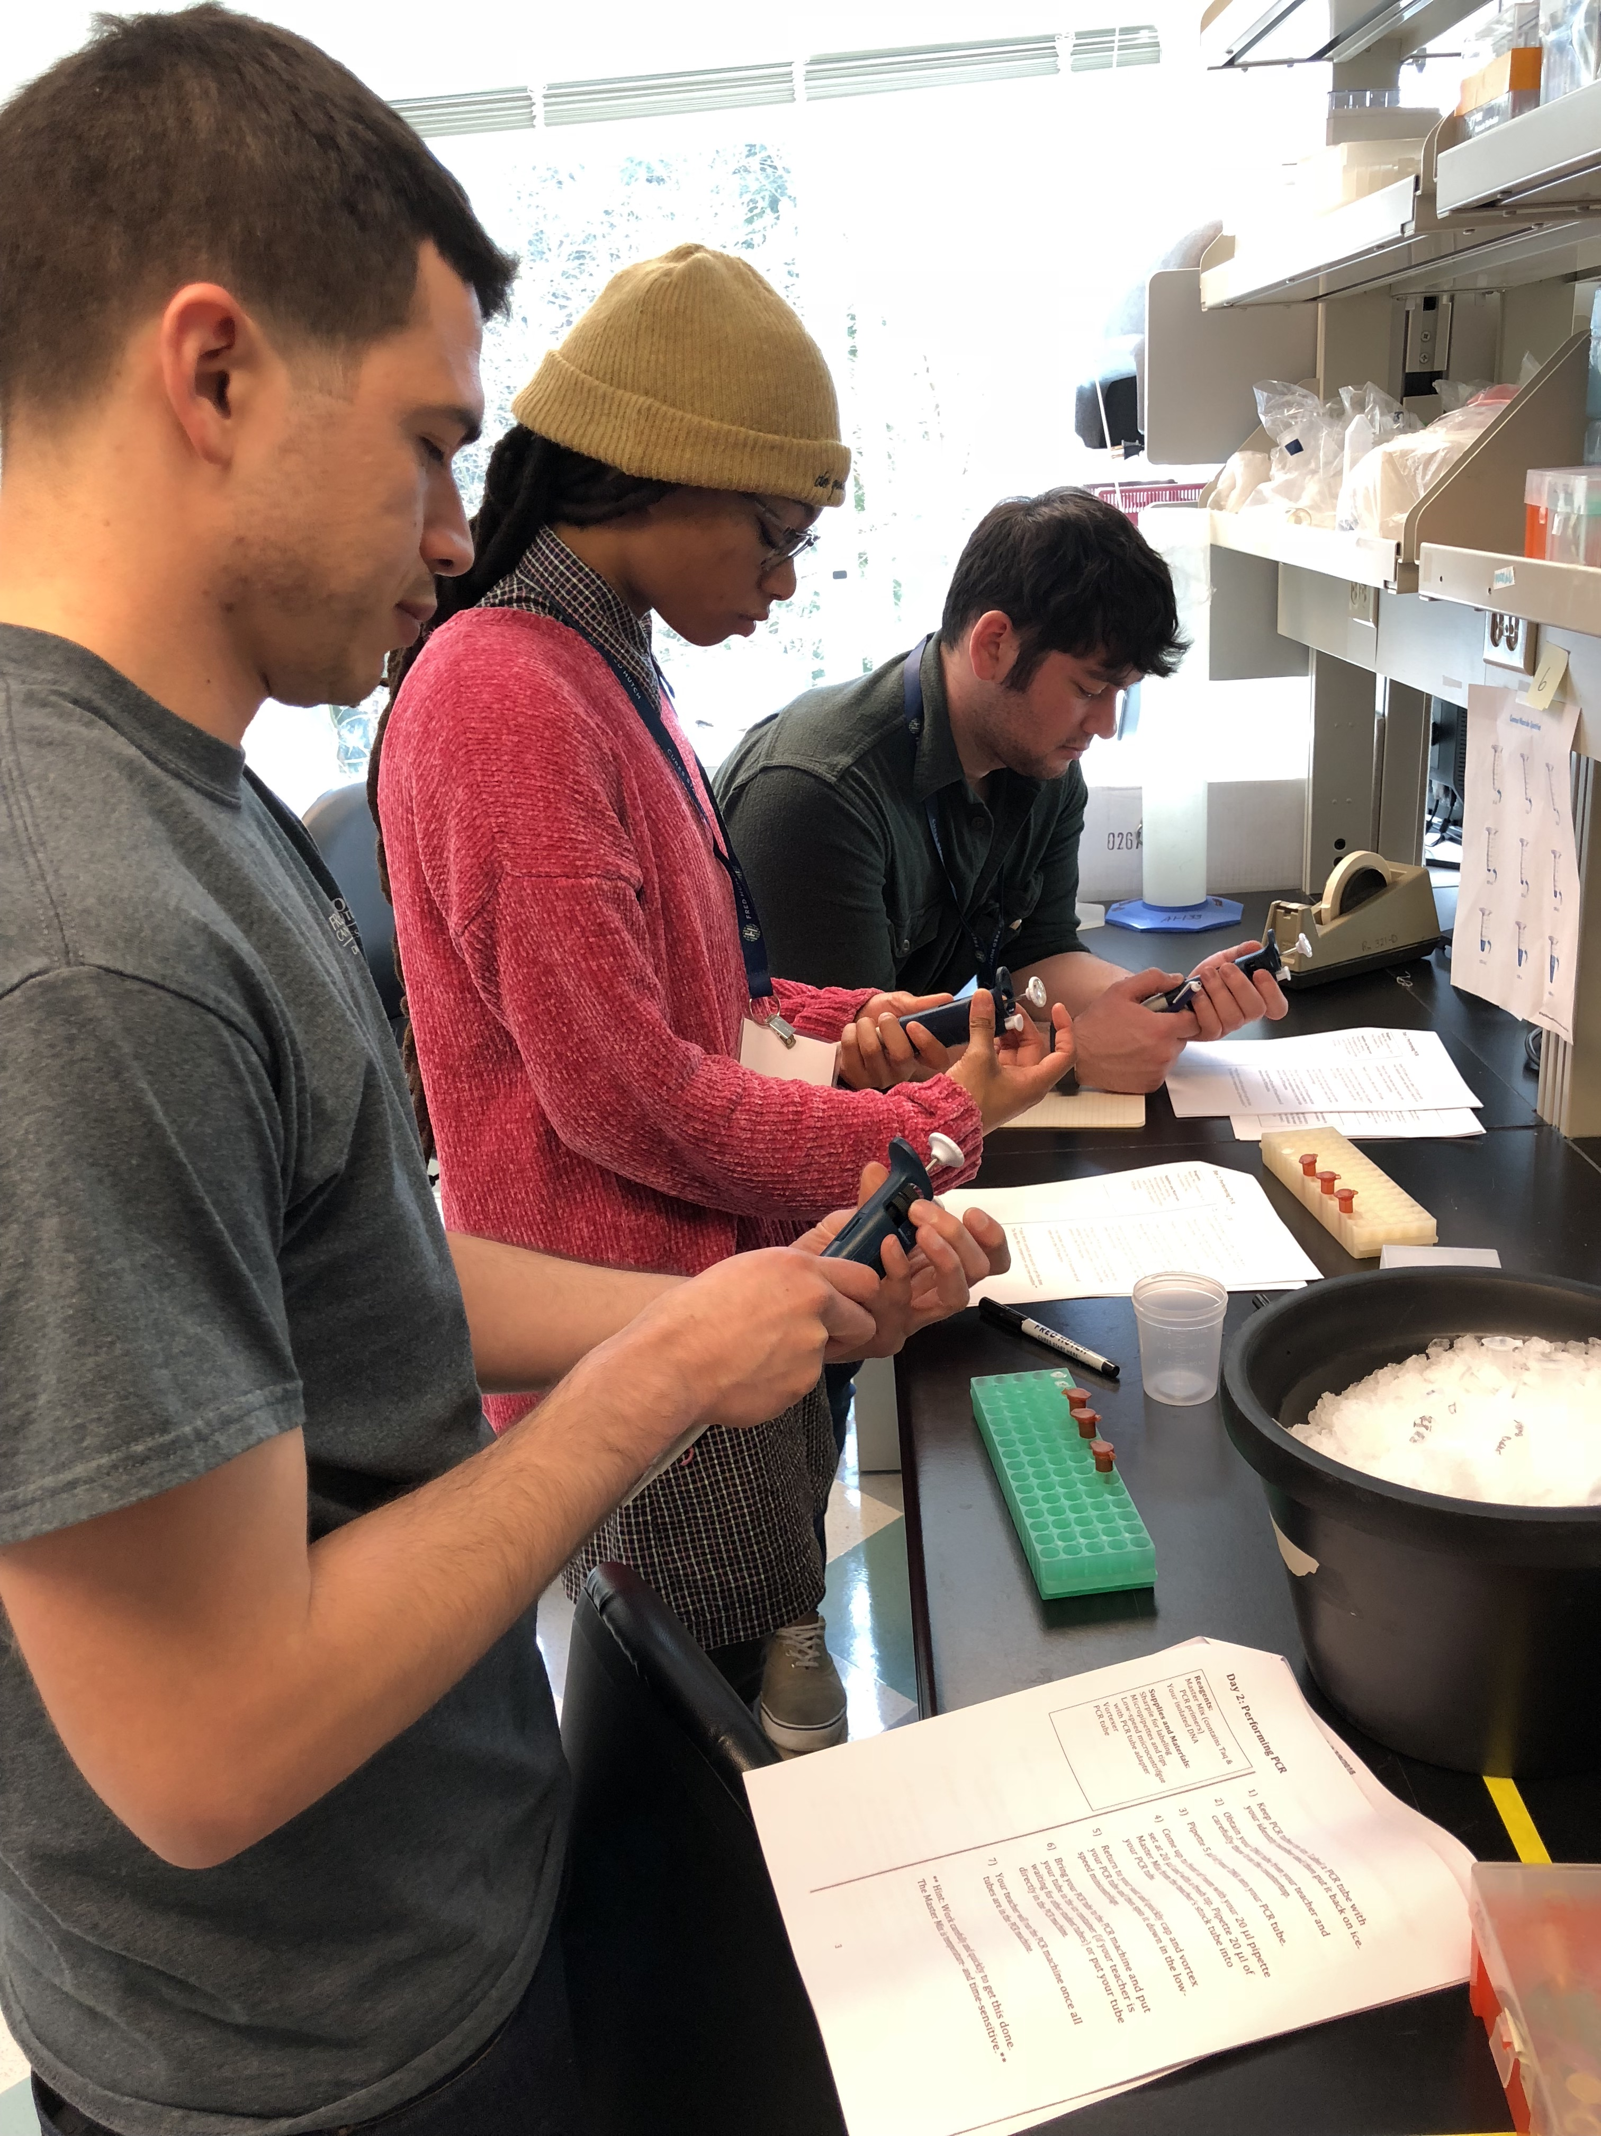
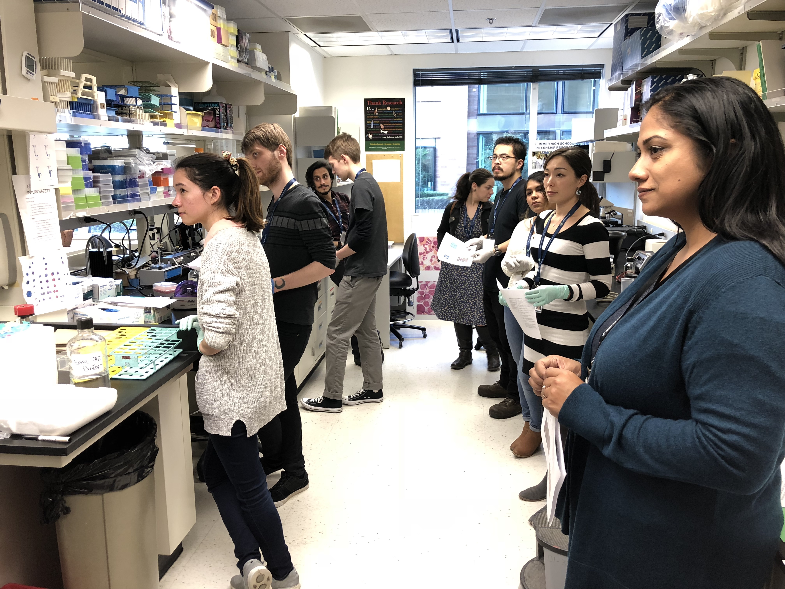
Hutch United – Seattle Central College MESA Program Partnership
The partnership with Seattle Central College MESA is driven by Hutch United, but includes many volunteers and supporters across Fred Hutch: lab techs, PhD students, postdocs, PIs, administrative staff, event management staff, front desk staff, security, training labs, Center IT, SEP, HR, and ODEI.
MESA Programs are targeted to increase representation of women, Black/African Americans, Latinx/Hispanic, Native American/Alaskan, and Native Hawaiian/Pacific Islanders in STEM fields.
MESA = Mathematics, Engineering, Science Achievement

Slide 2
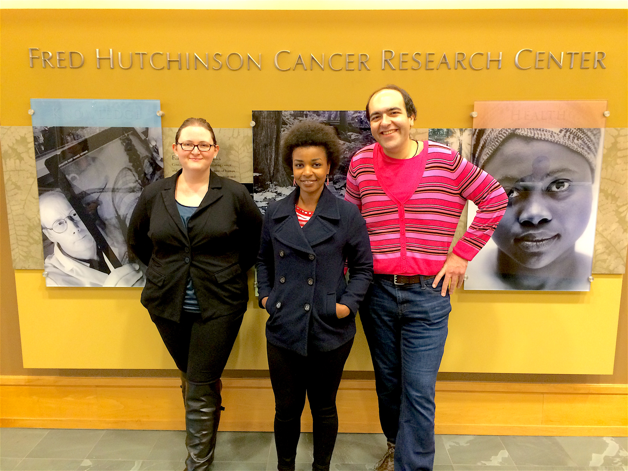
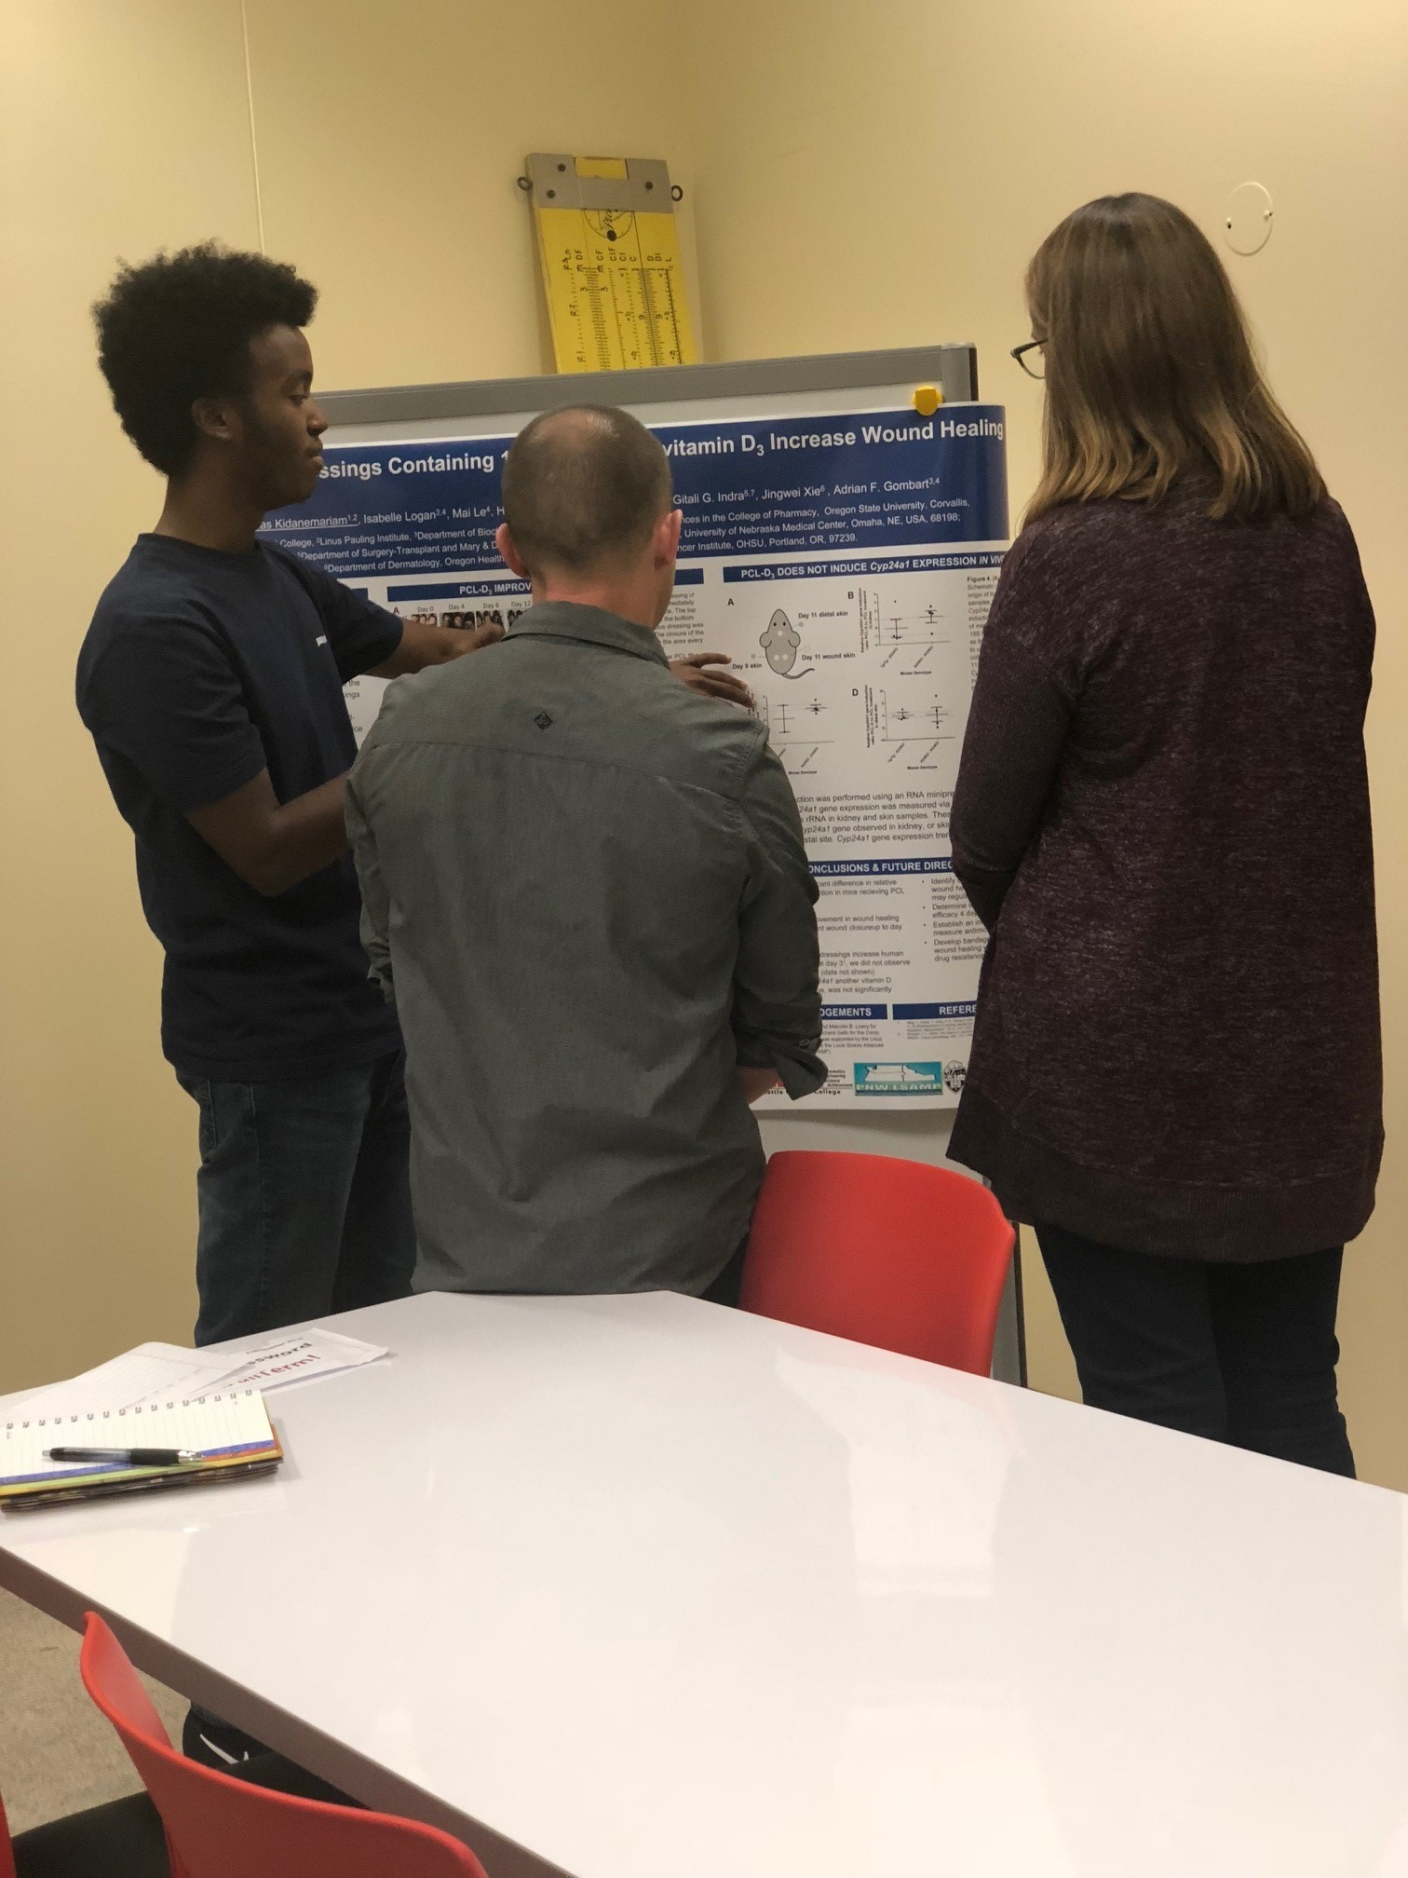
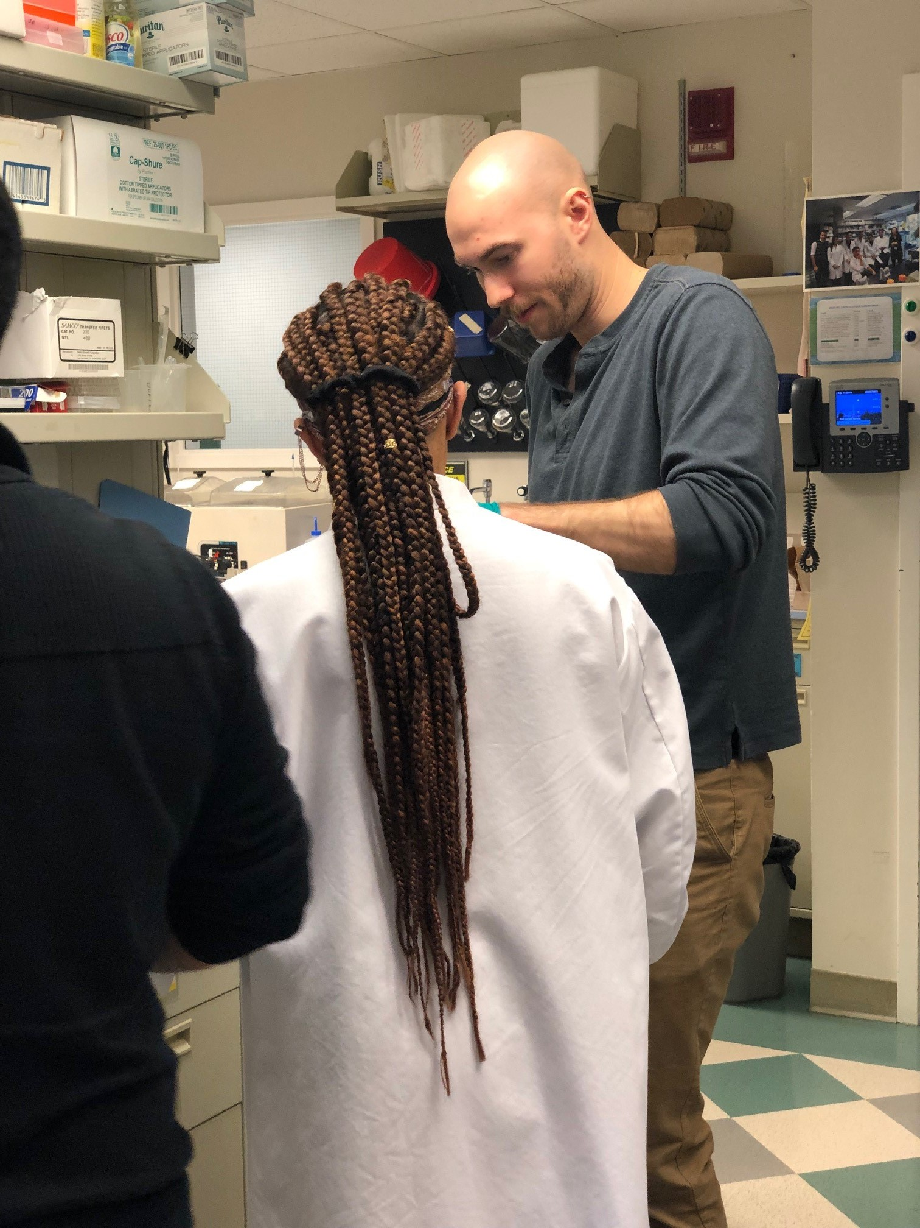
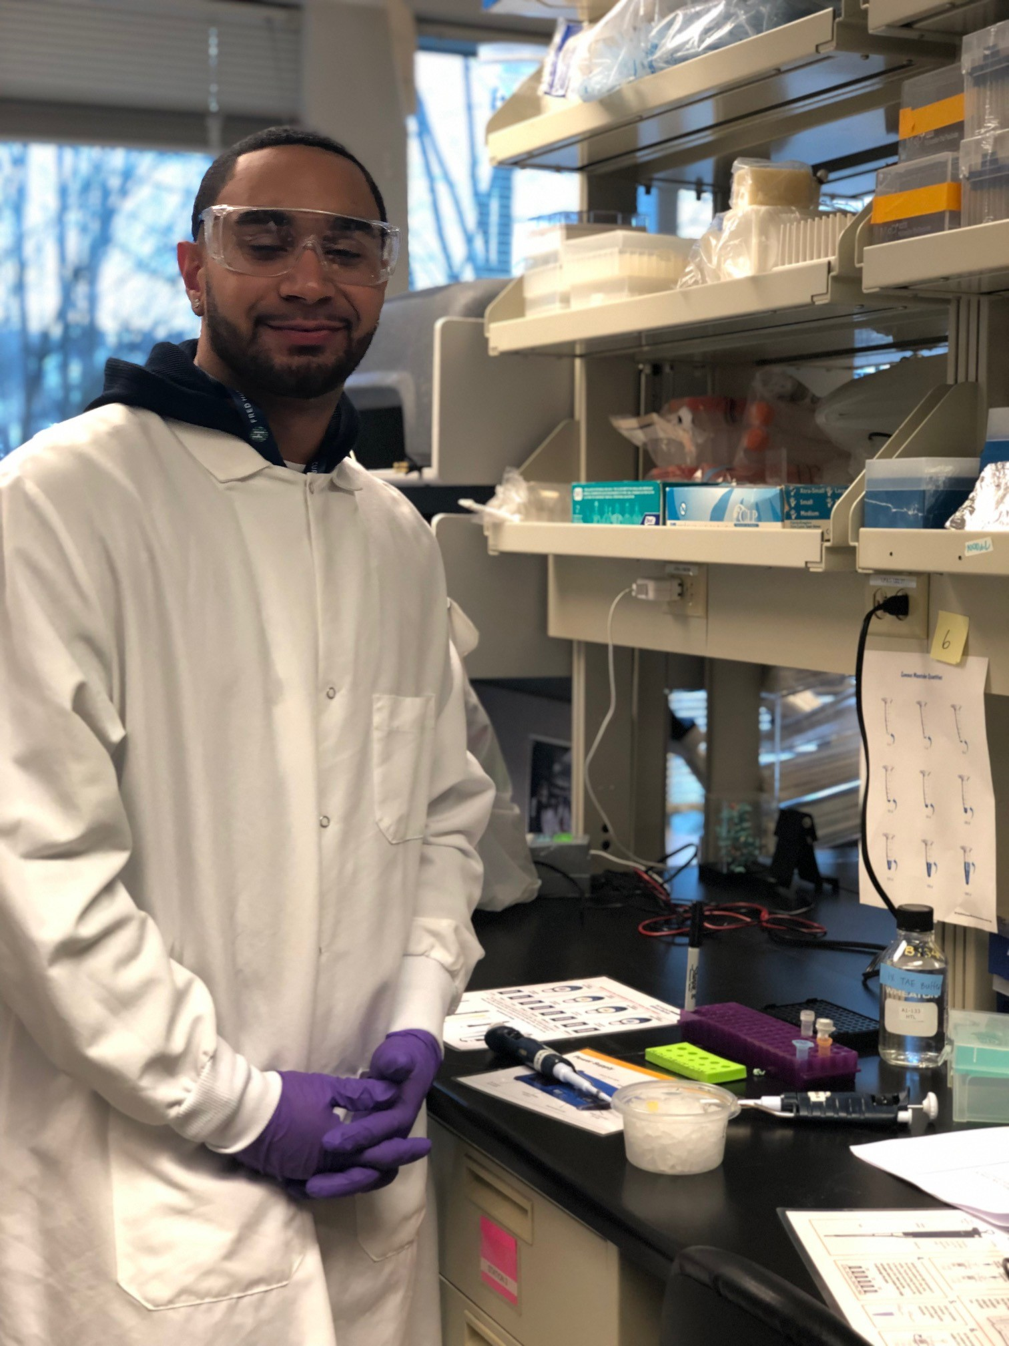
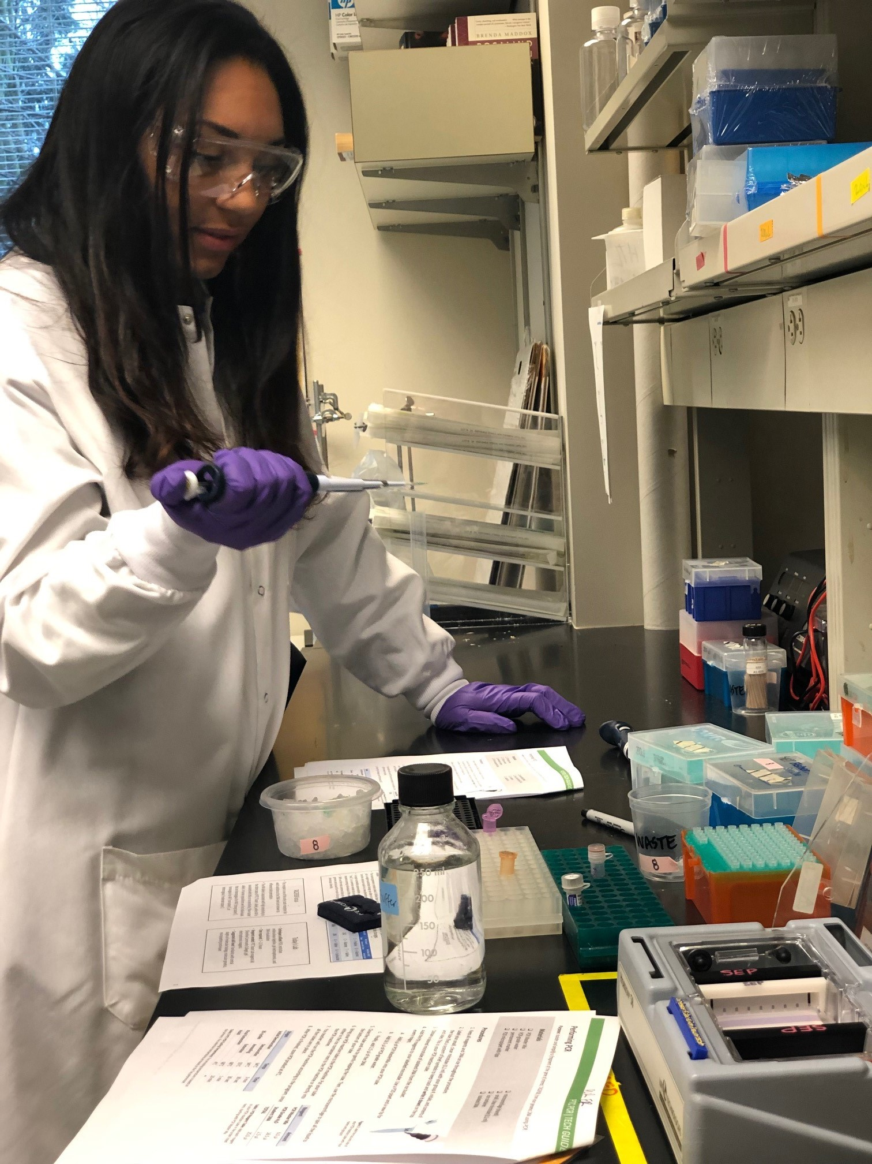
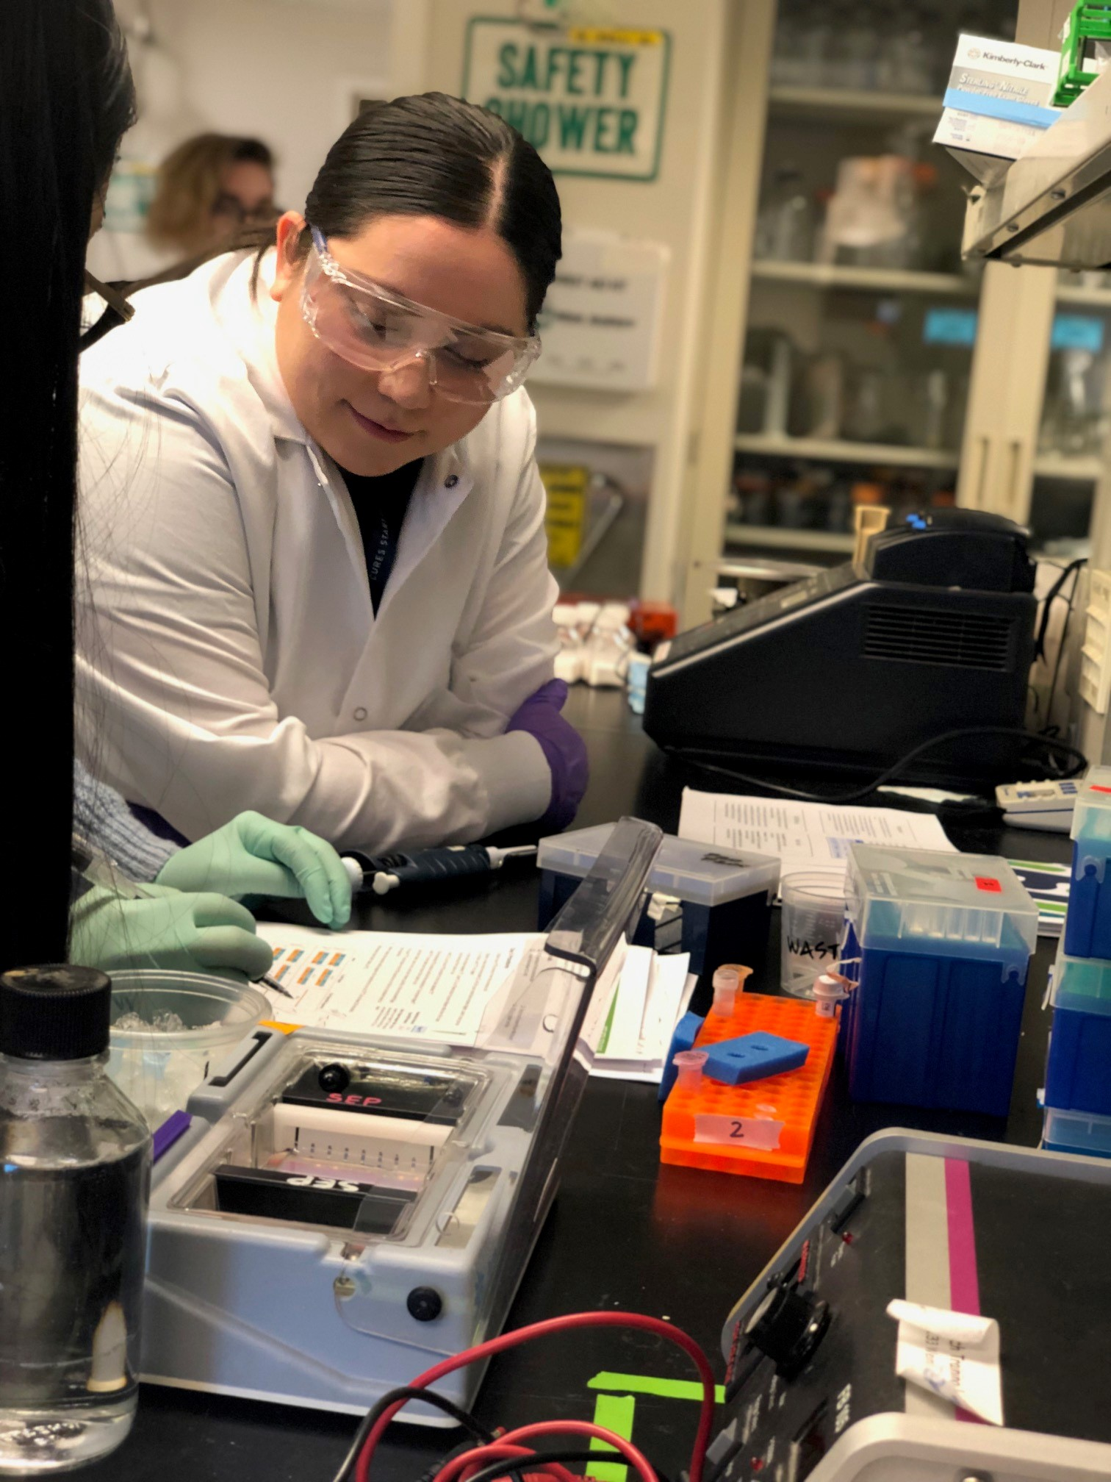
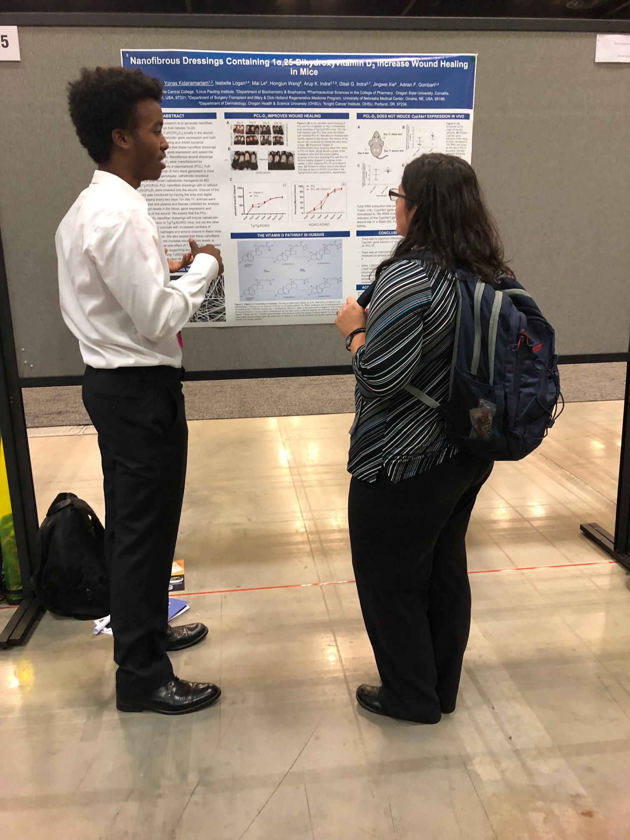
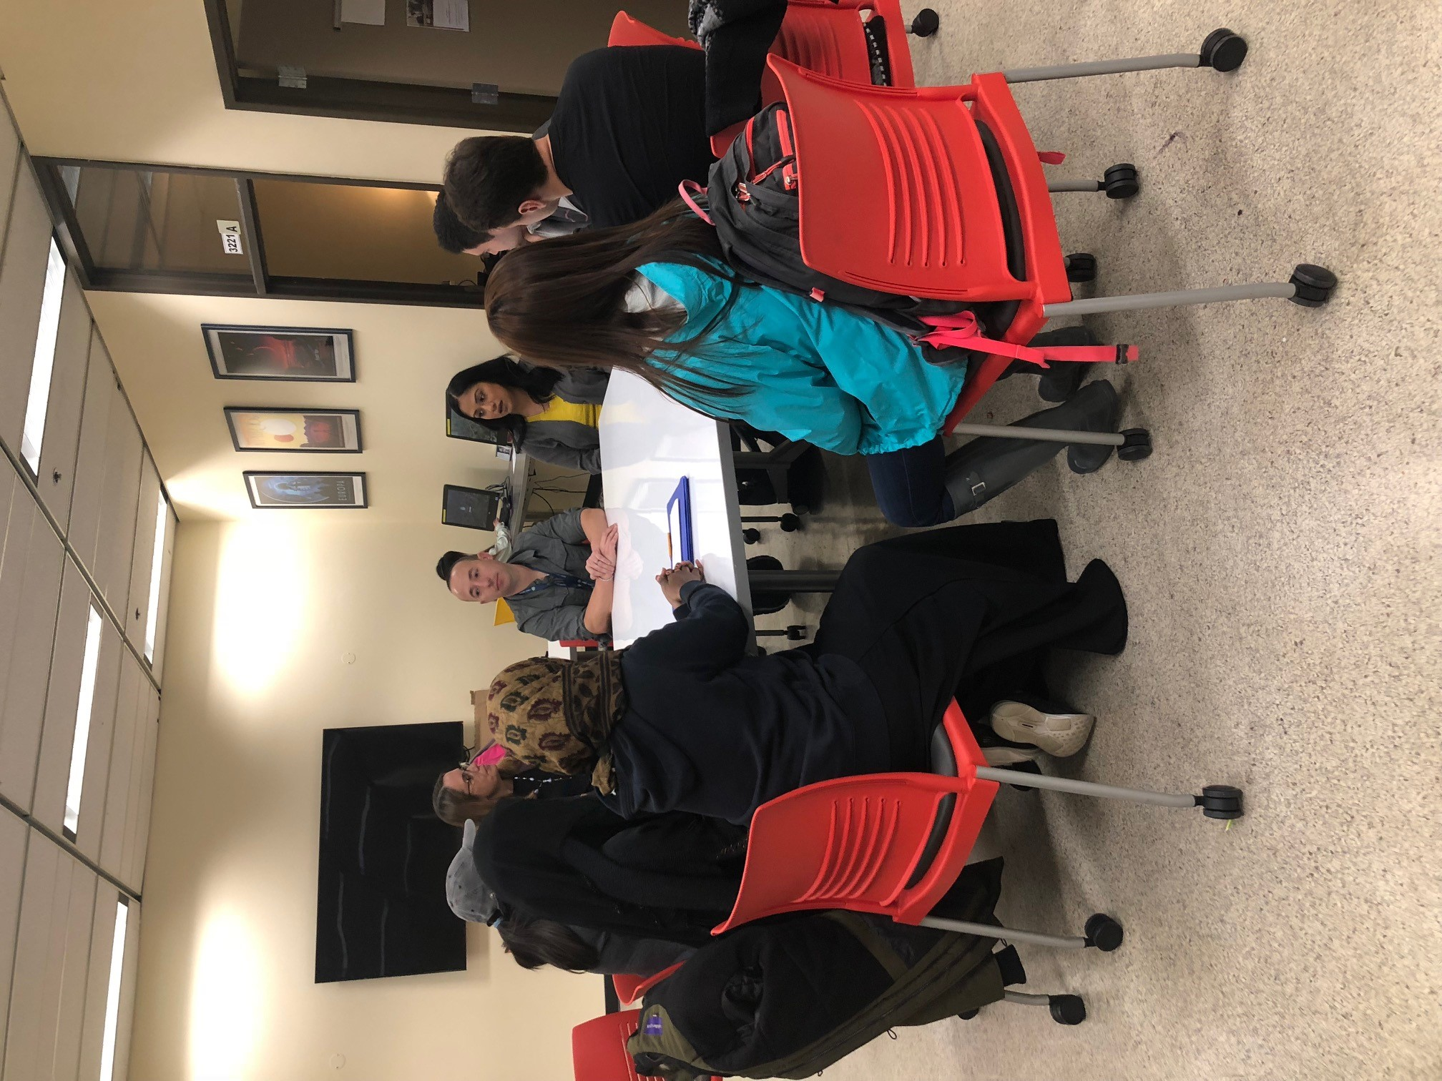
Hutch United – Seattle Central College MESA Program Partnership
2017 Fred Hutch Tour
2019 Lab Tour & Networking Lunch
Anthony Steinauer 2019 Pathways Intern
Pt lab assistant in the Torok-Storb lab
Camila Christensen 2020 Pathways Intern
The MESA & Hutch United partnership began in 2017 with a Fred Hutch tour and scientific seminar. Our partnership has grown to include yearly lab tours, networking lunches, scientific poster presentation assistance, guest speakers, and 7 internships from 2017 to 2020.
2018 Networking Lunch
Maira Perez
2018 intern in the Boeckh lab
Yonas Kidanemarian presenting at the 2019 SACNAS National Conference

Slide 3
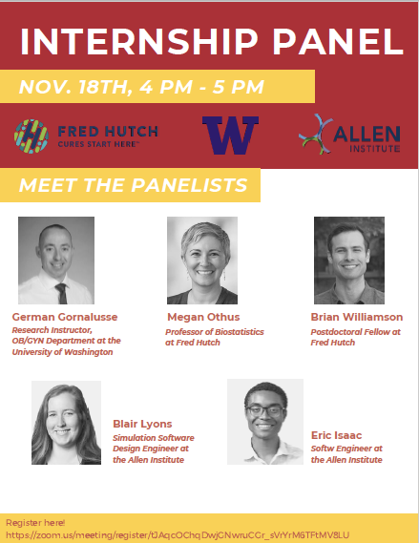
Hutch United – Seattle Central College MESA Program Partnership
2020 - 2021 Highlights
Partnership formalized via Memorandum of Understanding
Due to the pandemic, current activities focus on virtual options:
short-term internships
panel discussions
HU-MESA Partnership Managers:
Stephanie Shadbolt, Brian Williamson (Fred Hutch)
Marilyn Saavedra-Leyva (Seattle Central College)
Want to learn more? Ideas for activities?
Email: HUOutreach@fredhutch.org
MESA Program at Seattle Central College:
https://seattlecentral.edu/campus-life/student-support-and-services/mesa

